Slide 1
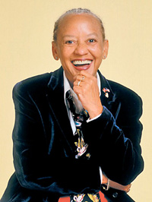
Nikki Giovanni
Courtney Wyche
“I really don't think life is about the I-could-have-beens. Life is only about the I-tried-to-do. I don't mind the failure but I can't imagine that I'd forgive myself if I didn't try.” - Giovanni

Slide 2
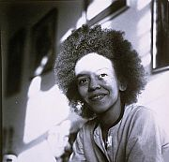
Biography
Yolanda Cornelia “Nikki” Giovanni was born in Knoxville, Tennessee on June 7, 1943. She grew up in an all black suburb in Cincinnati. Giovanni spent most of her summers with her sister at their grandparents home in Knoxville. She graduated from Fisk University in 1968, and later went on to attend the University of Pennsylvania and Columbia University. She is an honorary member of Delta Sigma Theta Sorority, Inc.

Slide 3
Giovanni only has one child. Thomas Watson Giovanni was born on August 31, 1969 when she was only 25. Giovanni had her son out of wedlock because she viewed marriage as, “ an institution that was inhospitable to women…”
Giovanni had always had a passion for writing in particular, poetry. Some critics say that when Thomas was born, her poetry became less angry.

Slide 4
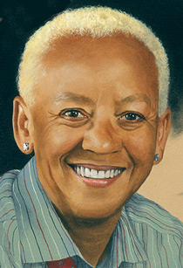
Poetry
Giovanni published her first work of poetry in 1968, entitled Black Feeling Black Talk. She was called the “princess of black poetry” early in her career. Her poems are very straight forward and she is known for her outspoken tone. Giovanni touches controversial subjects such as race, civil rights, and gender equality. She viewed herself as a revolutionary poet. She doesn’t write only about experience, but rather from empathy also. Her early works were influenced by the civil rights movement and black power movements.

Slide 5
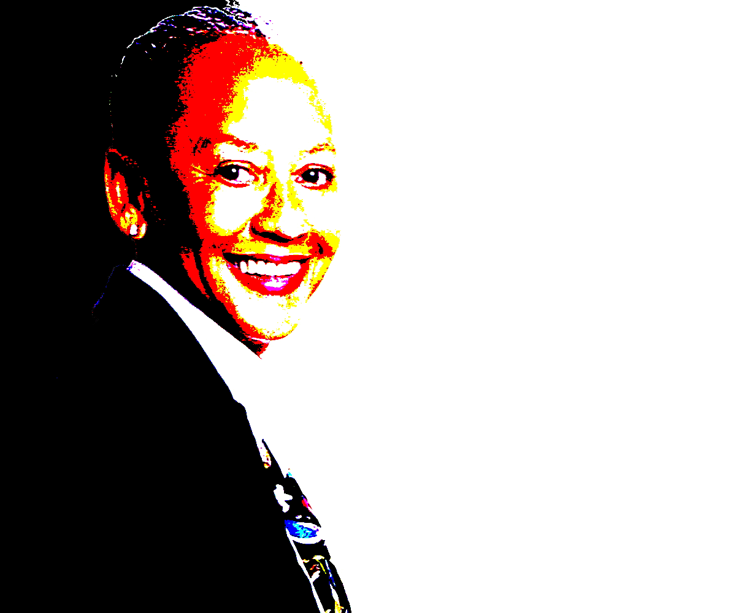
In reference to her ancestors, Giovanni would use food to describe them in her poems and also reference them to something of comfort.
“It’s a sex object if you’re pretty and no love or love and no sex if you’re fat…” quote taken from Woman Poem, which is a featured poem in Black Feeling Black Talk.
http://youtu.be/_xYL41PiuPg

Slide 6
Crutches
it's not the crutches we decry it's the need to move forward though we haven't the strength women aren't allowed to need so they develop rituals since we all know working hands idle the devil women aren't supposed to be strong so they develop social smiles and secret drinking problems and female lovers whom they never touch except in dreams
men are supposed to be strong so they have heart attacks and develop other women who don't know their weaknesses and hide their fears behind male lovers whom they religiously touch each saturday morning on the basketball court it's considered a sign of health doncha know that they take such good care of their bodies
i'm trying to say something about the human condition maybe i should try again

Slide 7
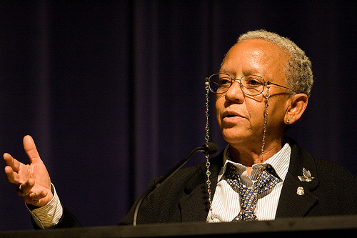
Today’s Giovanni
Giovanni was diagnosed with cancer in the late 90’s and eventually had to have a lung removed. She has been a professor of writing and literature at Virginia Tech since 1987. Her latest work, Bicycles: Love Poems, was published in 2009.

Slide 8
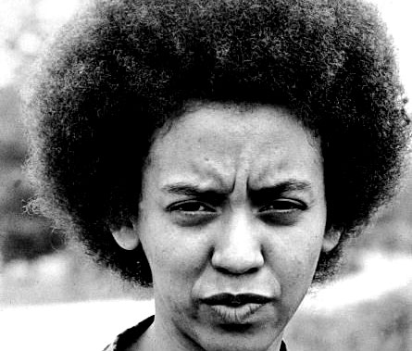
http://youtu.be/njnmFceEsuo

Slide 9
Bibliography
Bloom, Harold, and WJ Harris. African American Poets. New Edition. 2. NY, NY: An Imprint of Info-base Publishing, 2010. pp.17-28. Print
Fowler, V.. "NIKKI GIOVANNI'S APPALACHIAN TIES. " Appalachian Heritage 36.3 (2008): 42-52. Research Library, ProQuest. Web. 10 Apr. 2011.
Giovanni, Nikki. The Black Collegian, 09/2010. Interview. 34. Print. 10 Apr 2011. <http://theblackcollegiate.com>.
Nikki Giovanni. "Literature. " Obsidian III 3.1 (2001): 45. Research Library, ProQuest. Web. 10 Apr. 2011.
Walker , Jennifer. "Nikki Giovanni and Rita Dove: Poets Redefining ." Journal of Negro History. 85.3 (2000): pp. 210-217. Print

